Slide 1

HELLO
WE ARE MINIX!

Slide 2

FOOD GETS WASTED
PROBLEM

Slide 3
33% of food produced globally goes to waste every year
Even if just 25% of the food wasted could be saved, it would feed 870 million people in the world
In Turkey, the monetary cost of food waste is estimated to be more than200billion TL annually
PROBLEM
Source: Food and Agriculture Organization of the United Nations, Türkiye İsrafı Önleme Vakfı

Slide 4
“WHAT CAN WE DO WITH THE EXCESS FOOD BEING PRODUCED?”
THE QUESTION
IS NOT

Slide 5
“HOW CAN WE PRODUCE ONLY WHAT WE NEED (AND NOT MORE)?”
THE QUESTION
IS

Slide 6
At Boğaziçi University, we see cafeteria food being thrown out every day by the truckload
In other words, we also are part of the problem; we need to be part of the solution
We need to help food producers plan & produce more efficiently
WE FEEL THE PAIN

Slide 7

THE SOLUTION

Slide 8
A GAMIFIED MOBILE SERVICE that utilizes STUDENTS’ DATA AND PREFERENCES around food choices, campus presence and eating habits TO OPTIMIZE CATERING FIRMS’ FOOD PRODUCTION OPERATIONS
WHAT IT IS

Slide 9
Students utilize the app to rate potential menus (so that catering firm knows what’s in demand)
Students also rate each meal they eat at the cafeteria (also noting how much of the food they actually took is consumed)
Students earn rewards for their contribution (gamified to keep the data coming)
HOW IT WORKS
(user pov)

Slide 10

EXHIBIT A

Slide 11
Catering firm collects all user data coming in from the app
Data gets aggregated into informative, intuitive dashboards (for insight)
Catering firm optimizes weekly and daily food production schedules using collected data
HOW IT WORKS
(firm pov)

Slide 12
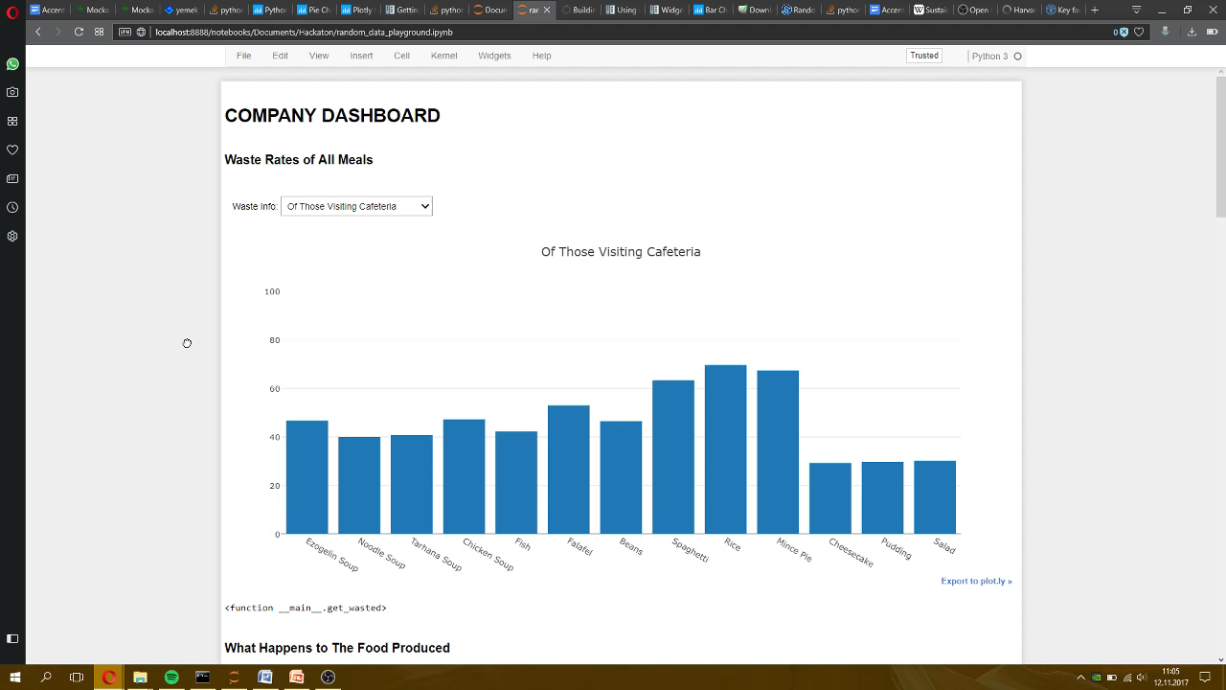
- BOUN CATERING OPERATIONS
EXHIBIT B

Slide 13
FREE TO USE FOR THE END-USER (students) – Students provide the data & get rewarded for their behavior
SaaS MODEL FOR BUSINESSES – Service, data and analytics provided to catering firms; revenue generated in the form of percentage of total cost savings provided
SCALABLE TO ALL TYPES OF BUSINESSES WITH CATERING OPERATIONS – Hotels, hospitals, workplaces, government agencies etc.
BUSINESS MODEL

Slide 14
ADAPABLE TO THRIVING TECHNOLOGIES (to make data collection richer)
Image Processing (capture what’s left on your plate)
IoT – Smart Plates (more accurate measurements)
EMPOWERED BY AI
Rich data = Better planning optimization
INTEGRATION WITH OTHER SYSTEMS
Automated procurement / supply chain operations (system orders food from supplier automatically based on needs)
Payment functionality to streamline user experience (pay with Unwasted)
FUTURE FEATURES

Slide 15
THANK YOU

